Slide 1
Fetch API
Introduction to Fetch | Fetching JSON | Post Request
Notes:
Welcome to our lecture on how to fetch API. In this lecture we will go through introduction to fetch API, how to fetch JSON, and will explore post request. Let’s start the video lecture.

Slide 2

Fetch API
The Fetch API provides the fetch() method to send HTTP requests and receive responses, replacing XMLHttpRequest with a simpler approach.
fetch() returns a Promise that resolves to a Response object, which contains details about the HTTP response and methods to retrieve the response body.
Notes:
The Fetch API simplifies making HTTP requests and receiving responses. It replaces the older XMLHttpRequest with a more modern approach. The fetch method returns a promise that resolves to a response object. This object contains details about the response and provides methods to retrieve the response body. Using Fetch API makes handling network requests easier. Next, we will see an example of using fetch in action.

Slide 3
Fetch API
response.status returns the HTTP status code (e.g., 200, 404).
response.ok is true for 2xx status codes, false otherwise.
response.headers holds the HTTP response headers.
response.text() returns a Promise that resolves with the response body as text.
Notes:
The Fetch API provides useful properties to handle HTTP responses. The status property returns the HTTP status code, like 200 for success or 404 for not found. The ok property is true for successful responses. The headers property stores response headers. The text method returns a promise that resolves with the response body as text. Next, we will explore how to handle JSON data using the Fetch API.

Slide 4
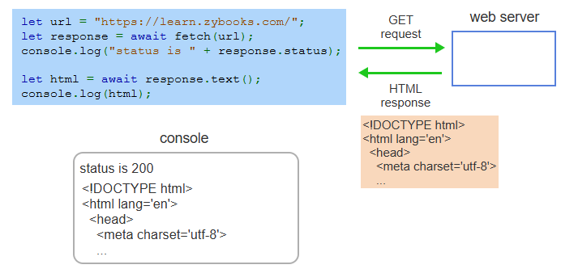
Example
Notes:
Let us see an example of using the Fetch API. This script sends a GET request to a website and retrieves the response. First, the fetch function is called with the URL. The response object is checked for its status, which prints 200 if successful. Then, the response text method extracts the HTML content. This is useful for fetching web pages. Next, we will see how to handle JSON data with Fetch.

Slide 5
Fetching JSON
The Fetch API is commonly used to request data from web APIs that return JSON.
response.json() converts the response body into a JavaScript object.
The animation below shows a request to the Random User Generator API for random user data.
Notes:
The Fetch API is commonly used to retrieve data from web APIs that return JSON. Instead of fetching plain text, we use the json method to convert the response body into a JavaScript object. This makes it easier to work with structured data. In the next example, we will see how to fetch data from the Random User Generator API and process it in JavaScript for further use.

Slide 6
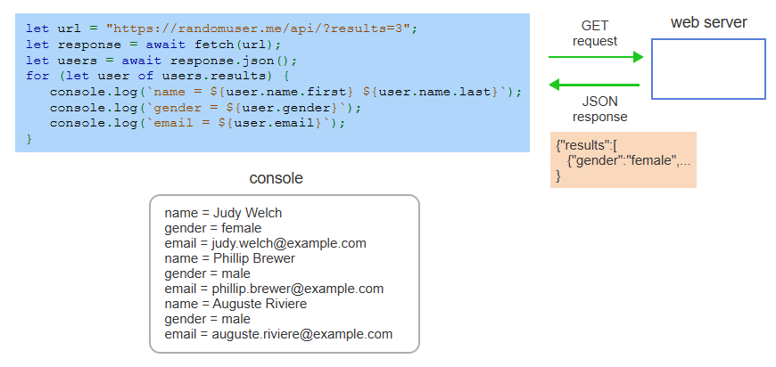
Example
Notes:
This example demonstrates how to fetch JSON data from an API. The fetch function sends a request to the Random User Generator API. The response is then converted to a JavaScript object using the json method. A loop iterates through the results to extract and display user details such as name, gender, and email. This approach is useful for working with dynamic API data. Next, we will explore handling errors in fetch requests.

Slide 7
Post Request
fetch() accepts an optional second parameter to modify the request.
method sets the HTTP method (GET, POST, PUT, DELETE).
headers defines HTTP request headers (e.g., Content-Type).
body contains the request data (e.g., JSON, form data, binary).
Notes:
A POST request allows sending data to a server using the Fetch API. The fetch function accepts a second parameter to configure the request. The method property specifies the HTTP method, such as POST. Headers define metadata like content type. The body contains the actual data to be sent, such as JSON or form data. This is useful for submitting forms or updating data. Next, we will see an example of making a POST request.

Slide 8
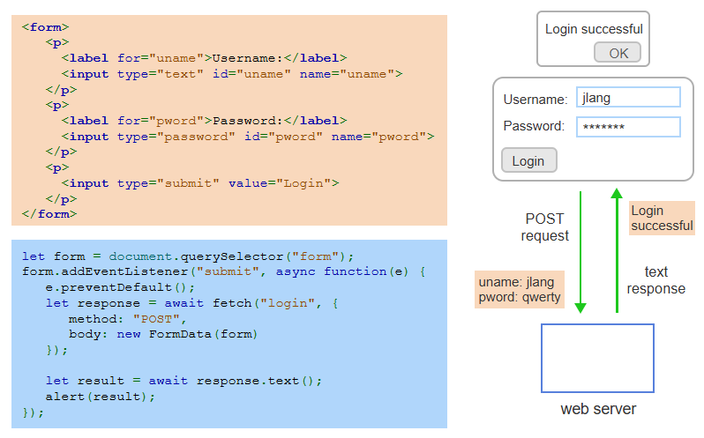
Example
Notes:
This example shows how to send a POST request using the Fetch API. A form captures the username and password. When the form is submitted, an event listener prevents the default action and sends the form data using fetch. The server responds with a success message, which is displayed in an alert. This method is useful for handling user authentication. Next, we will explore handling errors in fetch requests.

